Slide 1
Nebraska Climate Update 17 July 2023
University of Nebraska extension
School of natural resources
Eric Hunt
ehunt2@unl.edu
402-617-4190

Slide 2
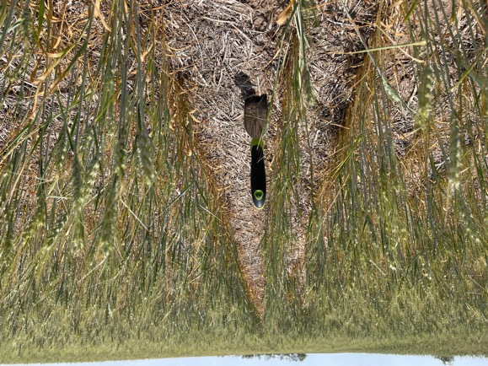
Outline
Drought in perspective
Current conditions, moisture deficits
Impacts
Climate outlook
Drought outlook
Credit: Nathan Mueller, University of Nebraska Extension
Notes:
Here I outlined the similar trends for the Nebraska and global annual average temperature. I also point out the high variability in Nebraska and difference in regional vs. global scales. I use the analogy that global change is like an escalator that is increasing at an accelerating rate. The variability is like we jump up or down a few steps while still going up.

Slide 3
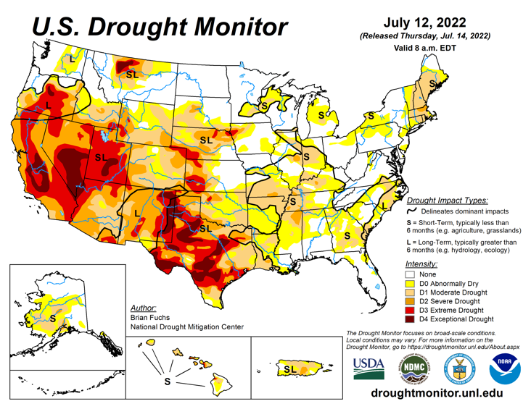
Drought in perspective
Conditions one year ago:
~50% of U.S. in drought.
Drought present throughout much of the country
Worst conditions in the west and in Texas
Notes:
Here I outlined the similar trends for the Nebraska and global annual average temperature. I also point out the high variability in Nebraska and difference in regional vs. global scales. I use the analogy that global change is like an escalator that is increasing at an accelerating rate. The variability is like we jump up or down a few steps while still going up.

Slide 4
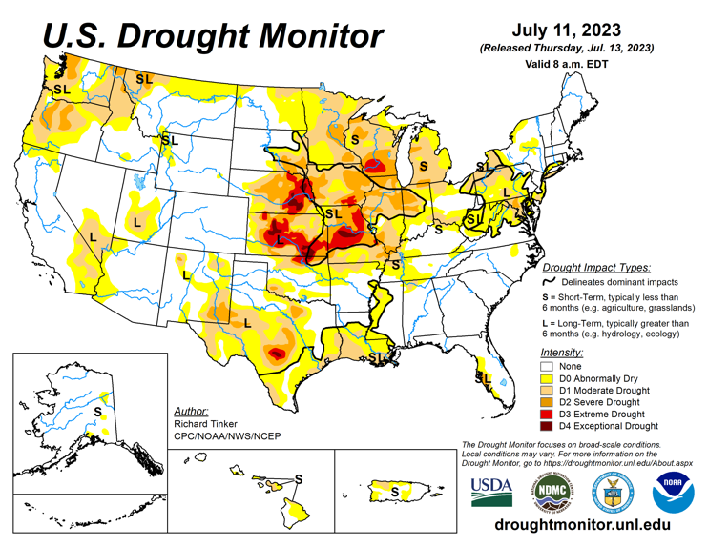
Drought in perspective
Conditions now:
Significant improvement in the west after a wet winter
Major improvement in western Nebraska
~2/3 Nebraska in drought.
Source: https://droughtmonitor.unl.edu/maps/
Notes:
Here I outlined the similar trends for the Nebraska and global annual average temperature. I also point out the high variability in Nebraska and difference in regional vs. global scales. I use the analogy that global change is like an escalator that is increasing at an accelerating rate. The variability is like we jump up or down a few steps while still going up.

Slide 5
Drought in perspective
Source: https://droughtmonitor.unl.edu/maps/
Notes:
Here I outlined the similar trends for the Nebraska and global annual average temperature. I also point out the high variability in Nebraska and difference in regional vs. global scales. I use the analogy that global change is like an escalator that is increasing at an accelerating rate. The variability is like we jump up or down a few steps while still going up.

Slide 6
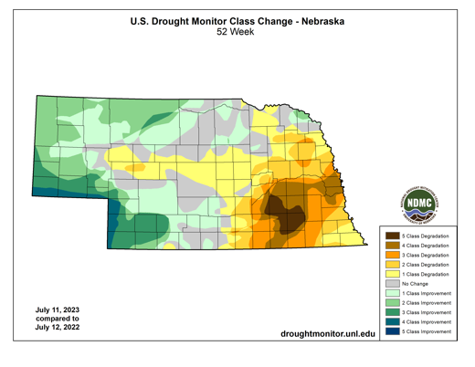
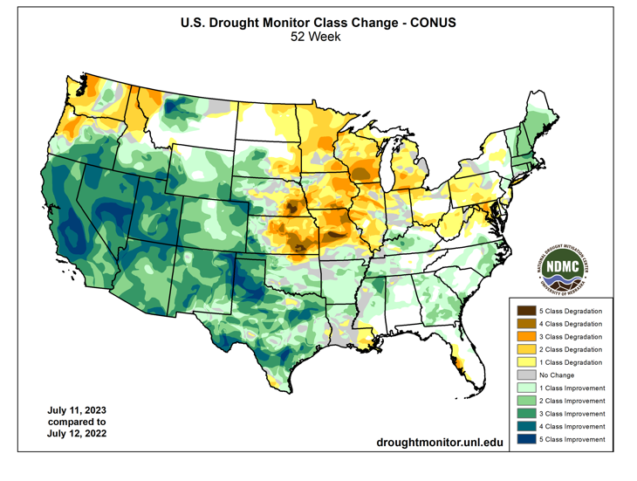
Drought in perspective
Source: https://droughtmonitor.unl.edu/maps/
Notes:
Here I outlined the similar trends for the Nebraska and global annual average temperature. I also point out the high variability in Nebraska and difference in regional vs. global scales. I use the analogy that global change is like an escalator that is increasing at an accelerating rate. The variability is like we jump up or down a few steps while still going up.

Slide 7
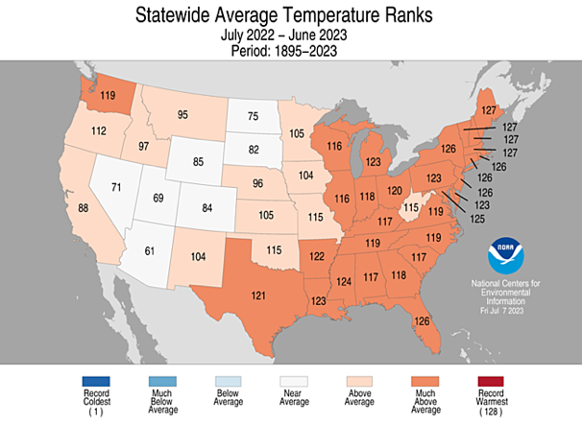
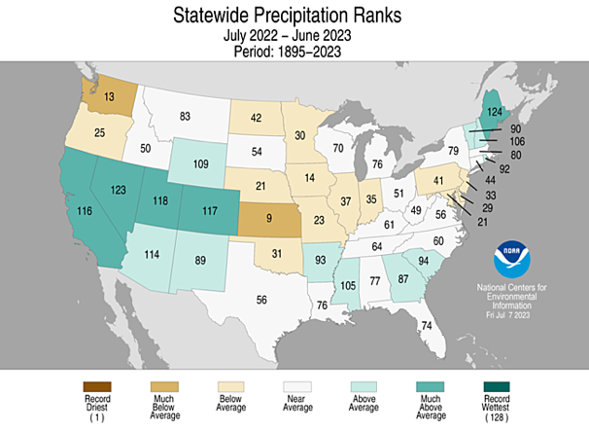
How did we get here?
Warmer than average and dry over the last year but this isn’t the whole story.
Notes:
Here I outlined the similar trends for the Nebraska and global annual average temperature. I also point out the high variability in Nebraska and difference in regional vs. global scales. I use the analogy that global change is like an escalator that is increasing at an accelerating rate. The variability is like we jump up or down a few steps while still going up.

Slide 8
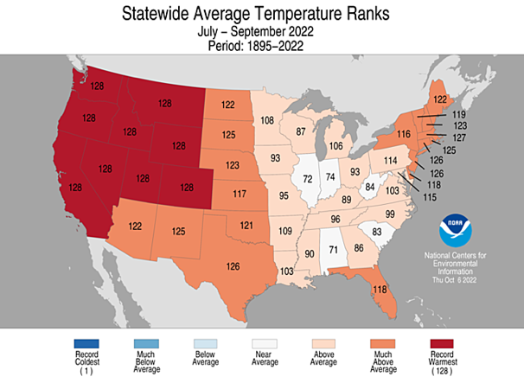
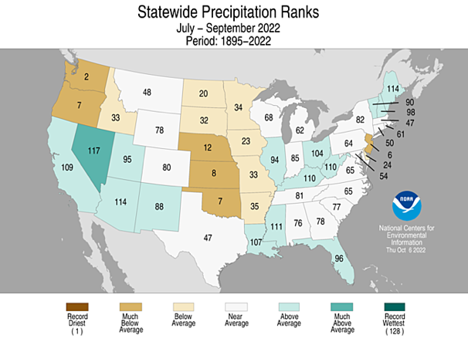
How did we get here?
Very warm and dry late summer and early fall. Drought worsens/flash drought in the southeastern part of NE.
Notes:
Here I outlined the similar trends for the Nebraska and global annual average temperature. I also point out the high variability in Nebraska and difference in regional vs. global scales. I use the analogy that global change is like an escalator that is increasing at an accelerating rate. The variability is like we jump up or down a few steps while still going up.

Slide 9
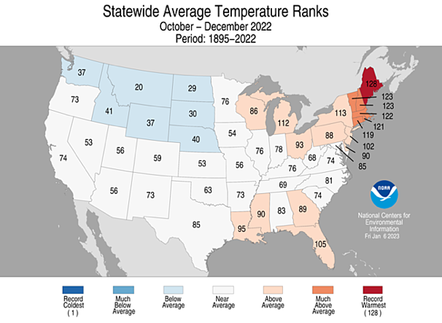
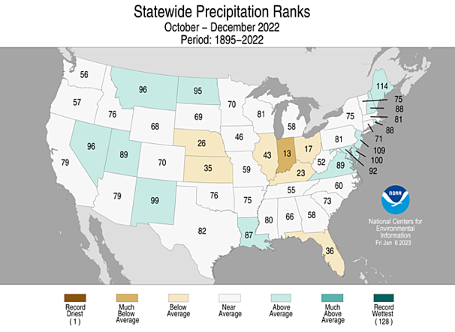
How did we get here?
We remained dry in the fall and early winter. But it also was generally on the cooler side, especially November.
Notes:
Here I outlined the similar trends for the Nebraska and global annual average temperature. I also point out the high variability in Nebraska and difference in regional vs. global scales. I use the analogy that global change is like an escalator that is increasing at an accelerating rate. The variability is like we jump up or down a few steps while still going up.

Slide 10
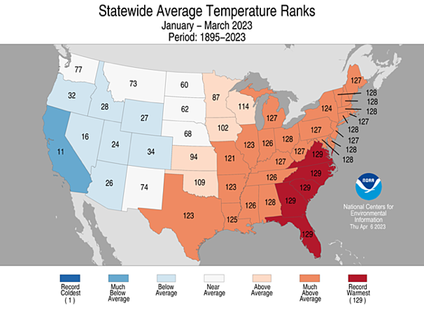
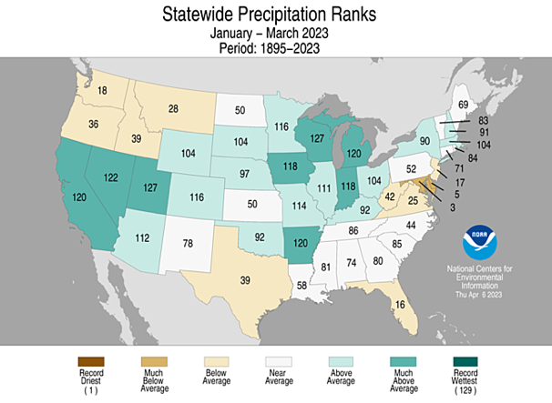
How did we get here?
Temperatures statewide were near average and it was wetter than average. But not wet enough to help improve the drought.
Notes:
Here I outlined the similar trends for the Nebraska and global annual average temperature. I also point out the high variability in Nebraska and difference in regional vs. global scales. I use the analogy that global change is like an escalator that is increasing at an accelerating rate. The variability is like we jump up or down a few steps while still going up.

Slide 11
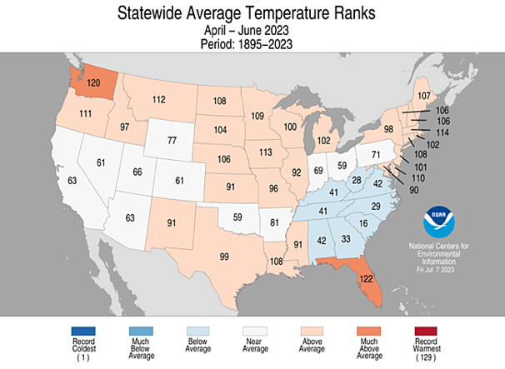
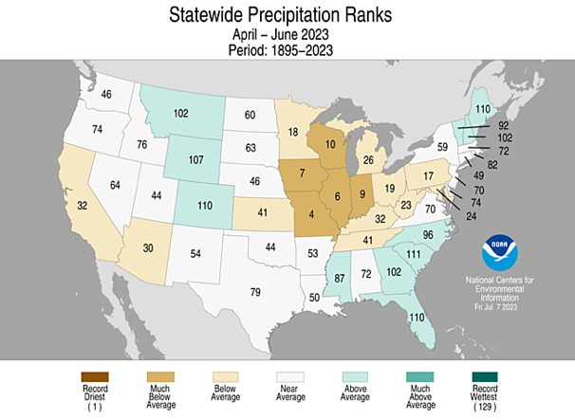
How did we get here?
Our spring and early summer was on balance warm and near average for precipitation. But this also isn’t the whole story.
Notes:
Here I outlined the similar trends for the Nebraska and global annual average temperature. I also point out the high variability in Nebraska and difference in regional vs. global scales. I use the analogy that global change is like an escalator that is increasing at an accelerating rate. The variability is like we jump up or down a few steps while still going up.

Slide 12
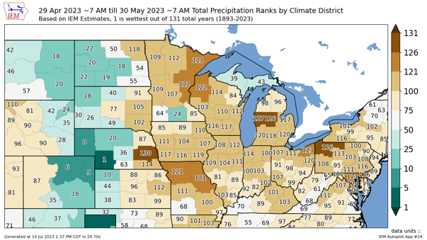
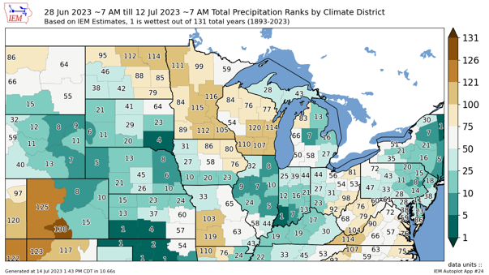
How did we get here?
After a dry April it turned wet, historically wet in some cases, in western Nebraska in May. Eastern Nebraska was very dry in May. This persisted until late June.
Notes:
Here I outlined the similar trends for the Nebraska and global annual average temperature. I also point out the high variability in Nebraska and difference in regional vs. global scales. I use the analogy that global change is like an escalator that is increasing at an accelerating rate. The variability is like we jump up or down a few steps while still going up.

Slide 13
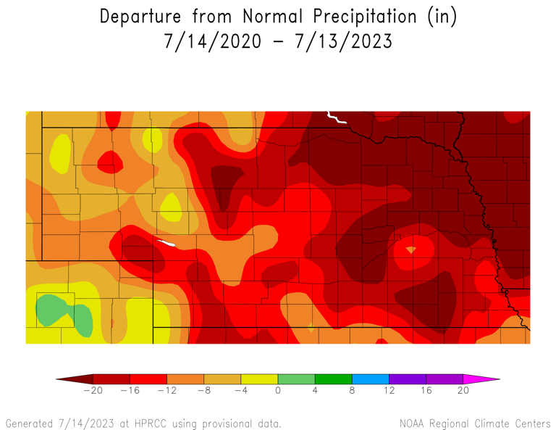
Long-term moisture deficits
2020 to Present
3-year precipitation deficits for much of the state in 12” range or worse.
Deficits worst in northeast Nebraska
Notes:
Here I outlined the similar trends for the Nebraska and global annual average temperature. I also point out the high variability in Nebraska and difference in regional vs. global scales. I use the analogy that global change is like an escalator that is increasing at an accelerating rate. The variability is like we jump up or down a few steps while still going up.

Slide 14
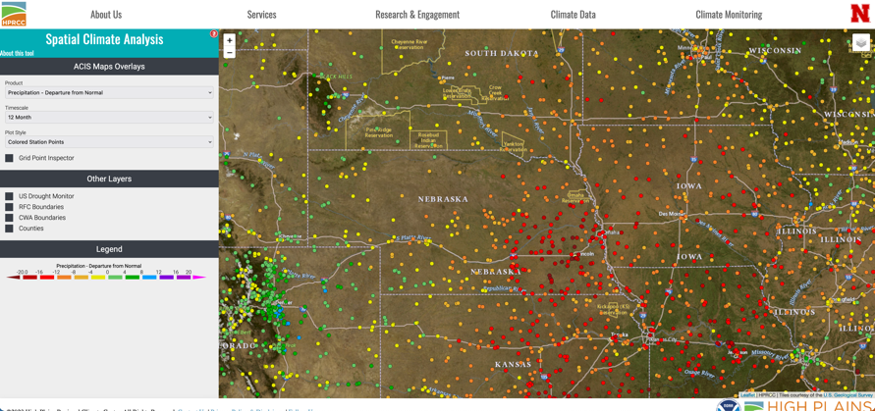
12-month moisture deficits
Surpluses and lower deficits in western Nebraska.
12 – 18” deficits across much of eastern Nebraska. Worst in area just west of Lincoln.
Notes:
Here I outlined the similar trends for the Nebraska and global annual average temperature. I also point out the high variability in Nebraska and difference in regional vs. global scales. I use the analogy that global change is like an escalator that is increasing at an accelerating rate. The variability is like we jump up or down a few steps while still going up.

Slide 15
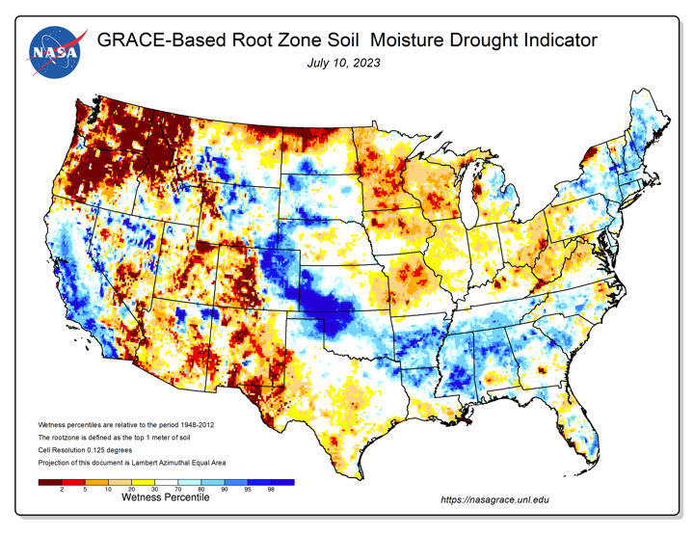
Impacts – Soil moisture
- 1 meter soil moisture based on GRACE-Follow on satellite data and a land surface model.
Significant improvements recently.
Notes:
Here I outlined the similar trends for the Nebraska and global annual average temperature. I also point out the high variability in Nebraska and difference in regional vs. global scales. I use the analogy that global change is like an escalator that is increasing at an accelerating rate. The variability is like we jump up or down a few steps while still going up.

Slide 16
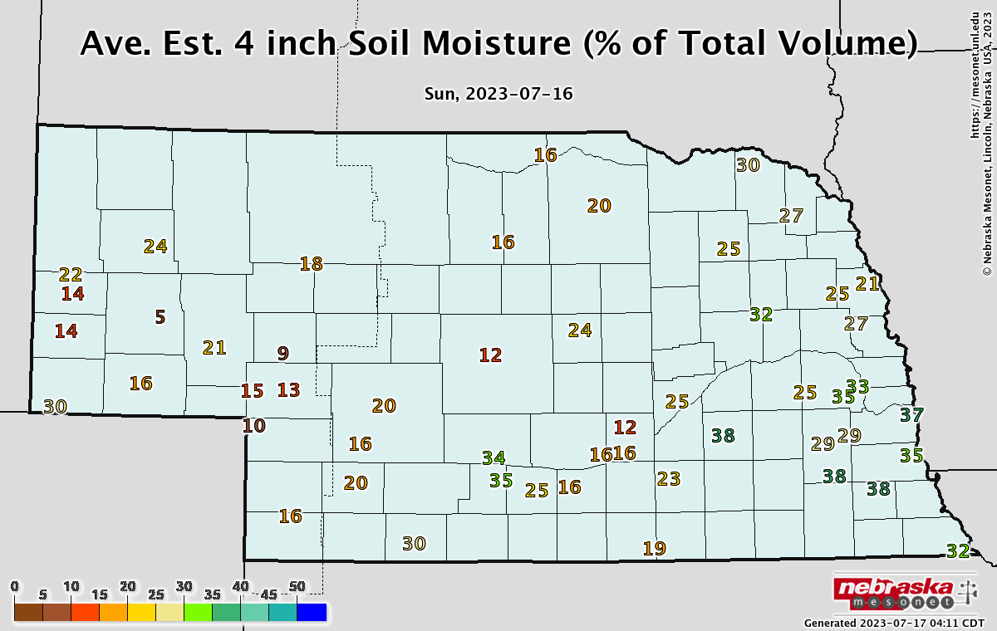
Impacts – Soil moisture
- Soil water content varies by soil type.
Conditions are indicative of the recent improvements.
Notes:
Here I outlined the similar trends for the Nebraska and global annual average temperature. I also point out the high variability in Nebraska and difference in regional vs. global scales. I use the analogy that global change is like an escalator that is increasing at an accelerating rate. The variability is like we jump up or down a few steps while still going up.

Slide 17
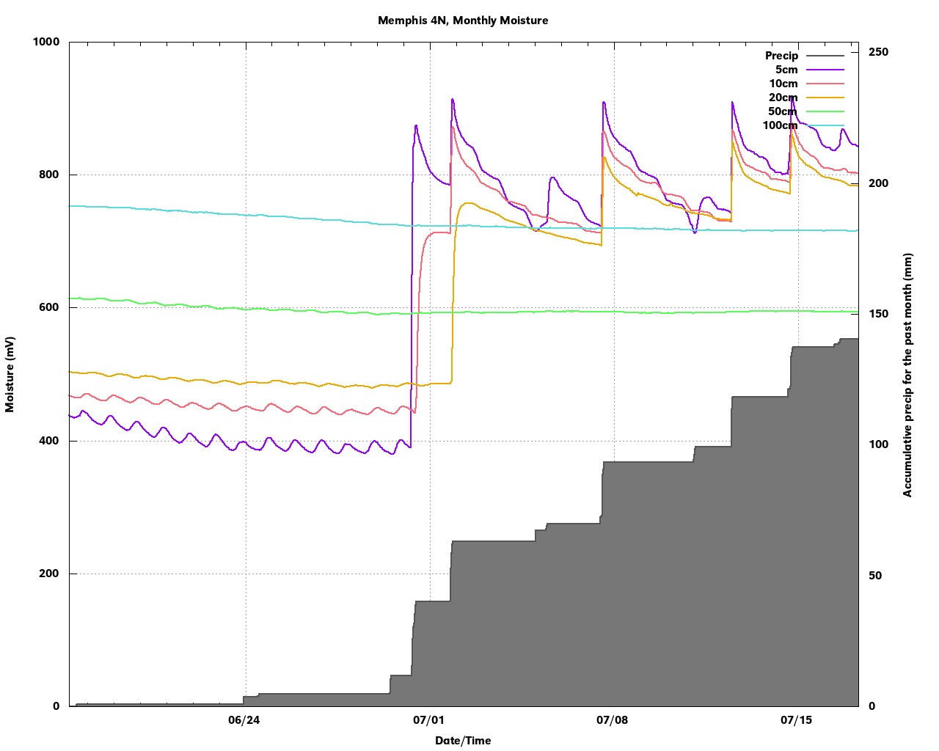
Impacts – Soil moisture
- Example of recent soil moisture improvements in eastern Nebraska
Notes:
Here I outlined the similar trends for the Nebraska and global annual average temperature. I also point out the high variability in Nebraska and difference in regional vs. global scales. I use the analogy that global change is like an escalator that is increasing at an accelerating rate. The variability is like we jump up or down a few steps while still going up.

Slide 18
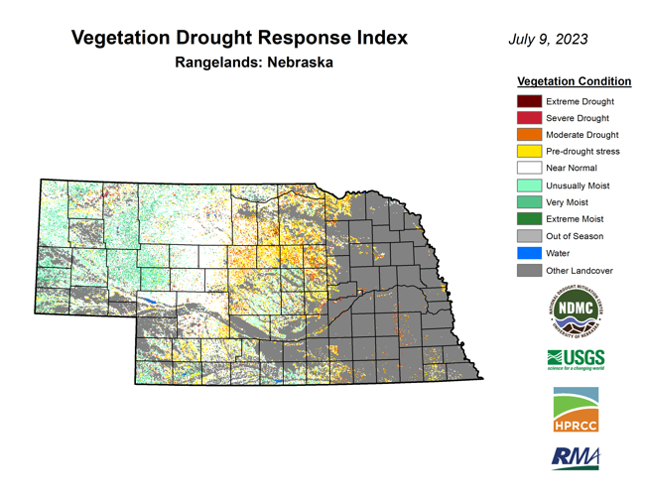
Impacts – pasture/range
Statewide NASS condition: 14% poor / very poor 52% good
Best in well over a year
Notes:
Here I outlined the similar trends for the Nebraska and global annual average temperature. I also point out the high variability in Nebraska and difference in regional vs. global scales. I use the analogy that global change is like an escalator that is increasing at an accelerating rate. The variability is like we jump up or down a few steps while still going up.

Slide 19
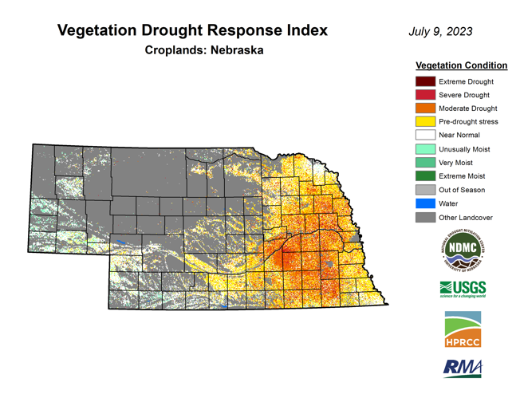
Impacts – crops
Statewide NASS condition:
15% and 19% of corn and soybean considered poor to very poor
Worse than normal but better than at the same point in 2002 or 2012
Wheat yields variable and likely lower than average
Notes:
Here I outlined the similar trends for the Nebraska and global annual average temperature. I also point out the high variability in Nebraska and difference in regional vs. global scales. I use the analogy that global change is like an escalator that is increasing at an accelerating rate. The variability is like we jump up or down a few steps while still going up.

Slide 20
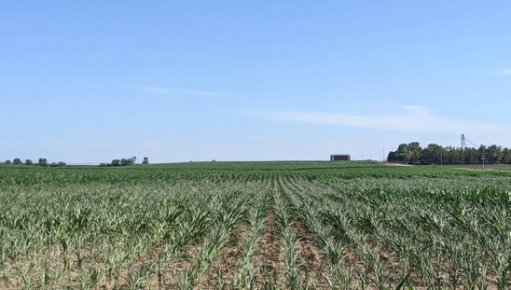
Impacts – Drought
Tremendous impacts to winter wheat in the eastern half of Nebraska
Very poor start for dryland corn in much of eastern NE, especially between Grand Island and Lincoln
Notes:
Here I outlined the similar trends for the Nebraska and global annual average temperature. I also point out the high variability in Nebraska and difference in regional vs. global scales. I use the analogy that global change is like an escalator that is increasing at an accelerating rate. The variability is like we jump up or down a few steps while still going up.

Slide 21
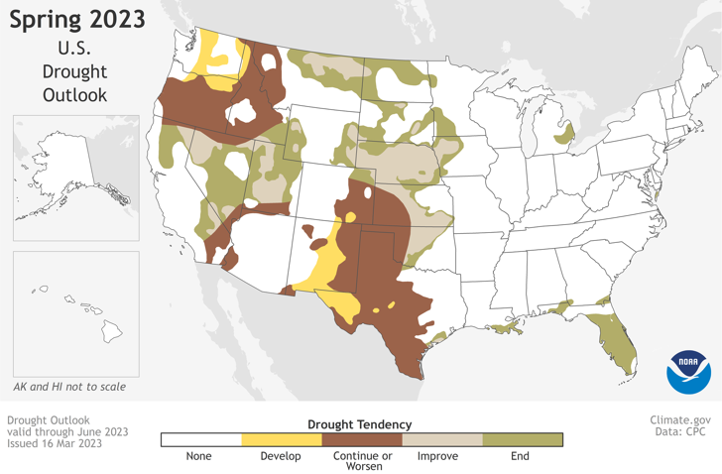
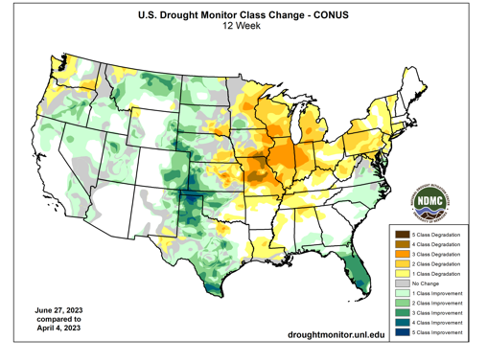
June drought ‘verification’
Drought persistence across Nebraska.
https://www.cpc.ncep.noaa.gov/
Notes:
Here I outlined the similar trends for the Nebraska and global annual average temperature. I also point out the high variability in Nebraska and difference in regional vs. global scales. I use the analogy that global change is like an escalator that is increasing at an accelerating rate. The variability is like we jump up or down a few steps while still going up.

Slide 22
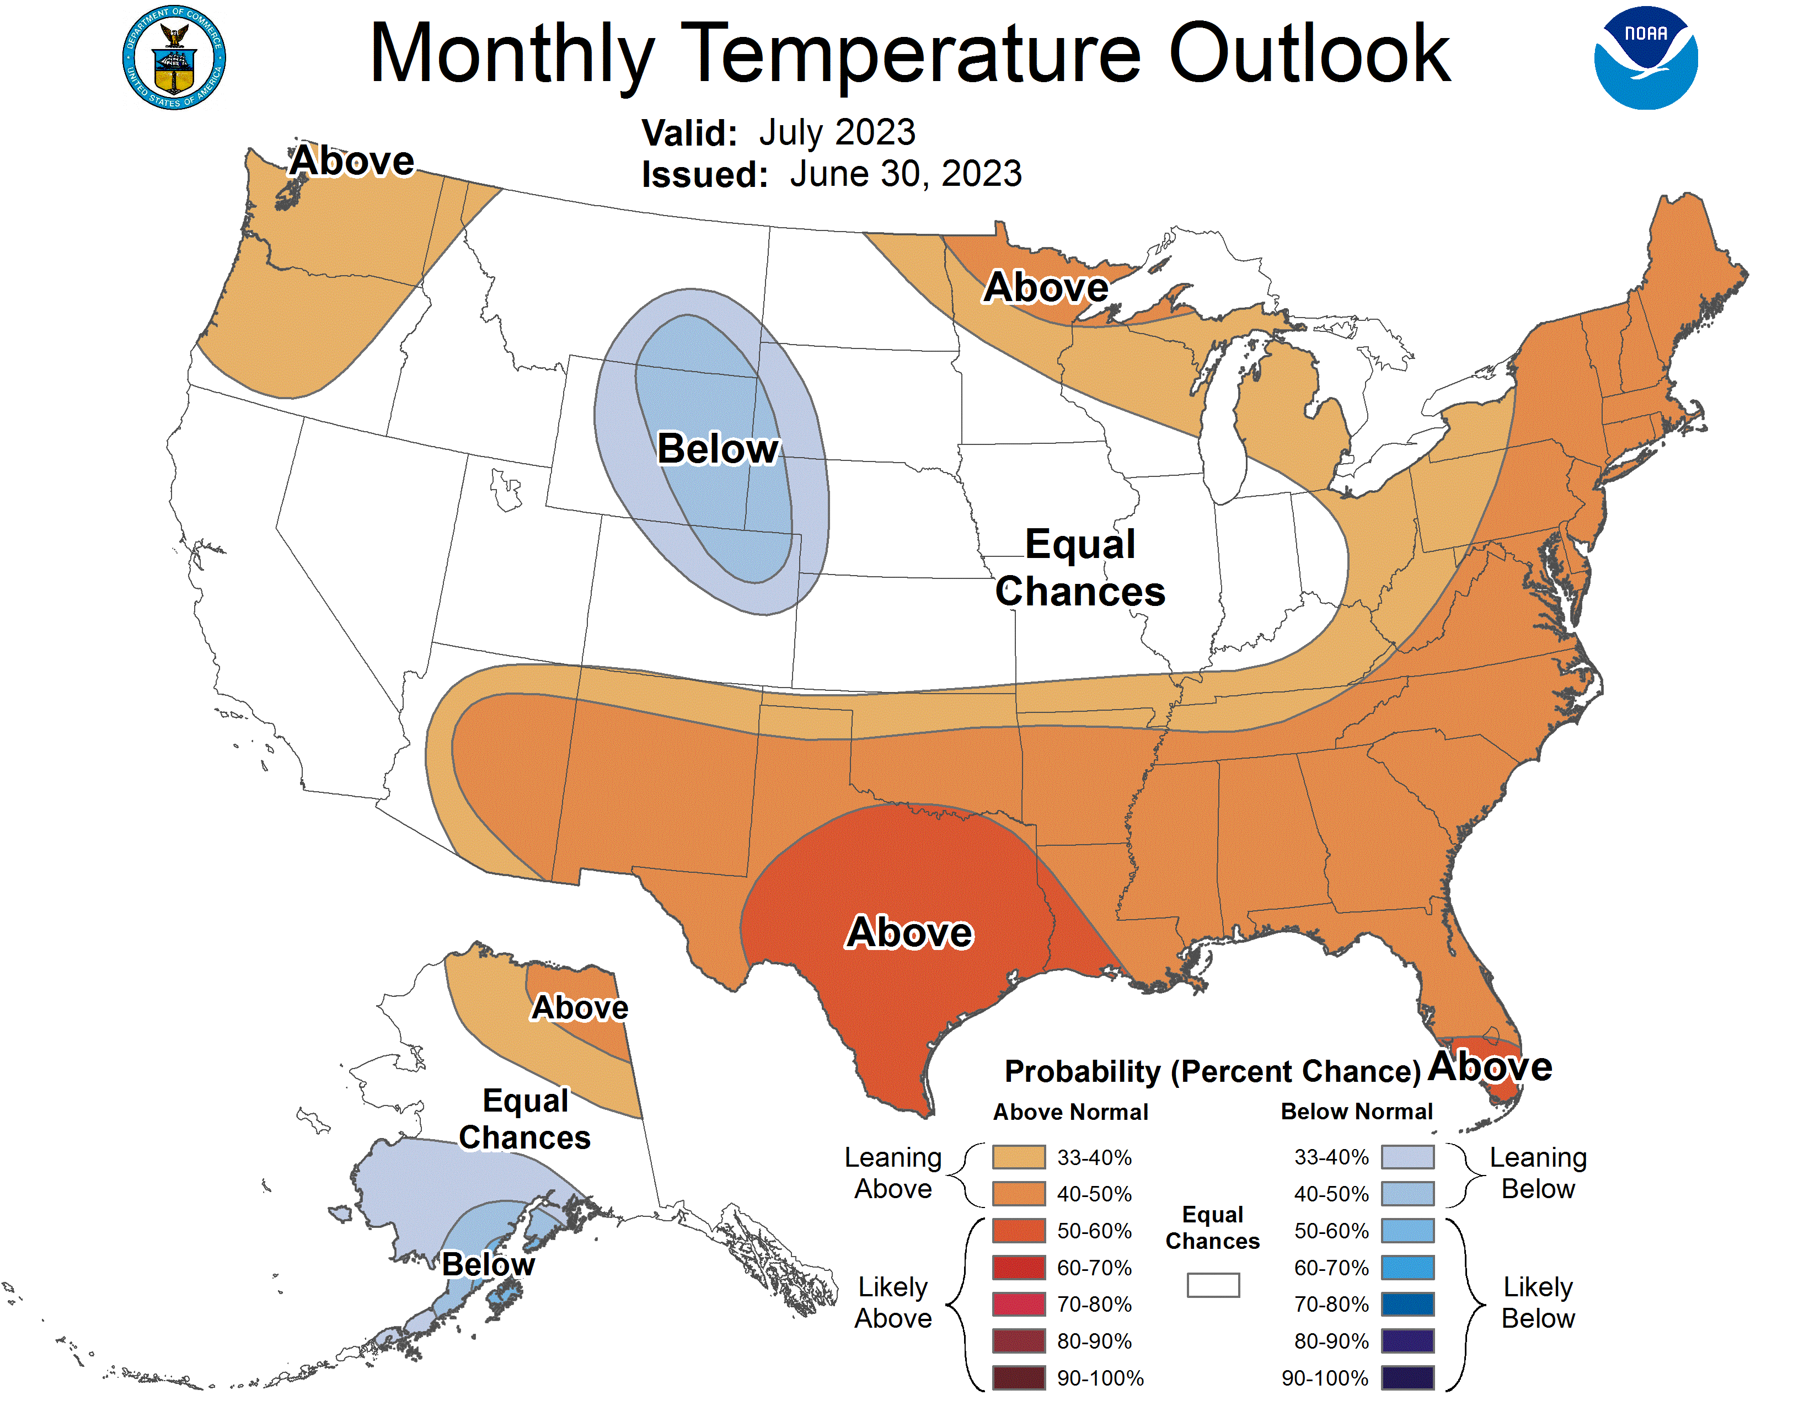
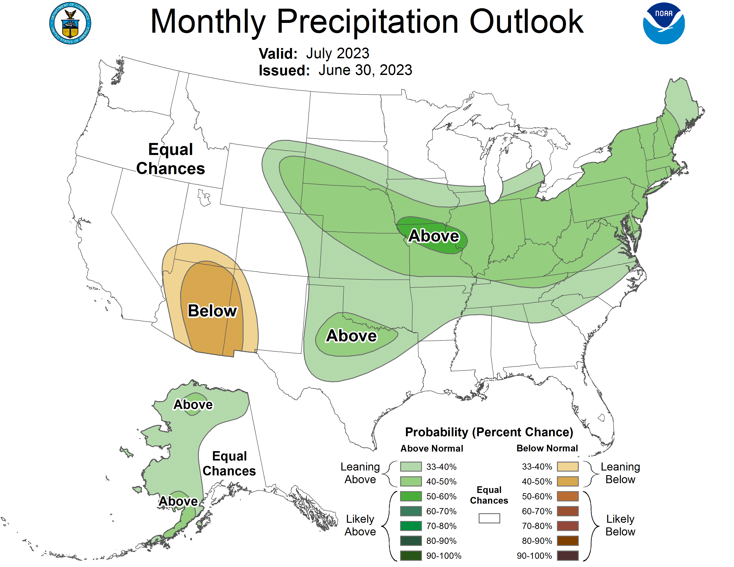
July climate outlook
Equal chances tendency for much of Nebraska. Precipitation was expected to be above average.
https://www.cpc.ncep.noaa.gov/
Notes:
Here I outlined the similar trends for the Nebraska and global annual average temperature. I also point out the high variability in Nebraska and difference in regional vs. global scales. I use the analogy that global change is like an escalator that is increasing at an accelerating rate. The variability is like we jump up or down a few steps while still going up.

Slide 23
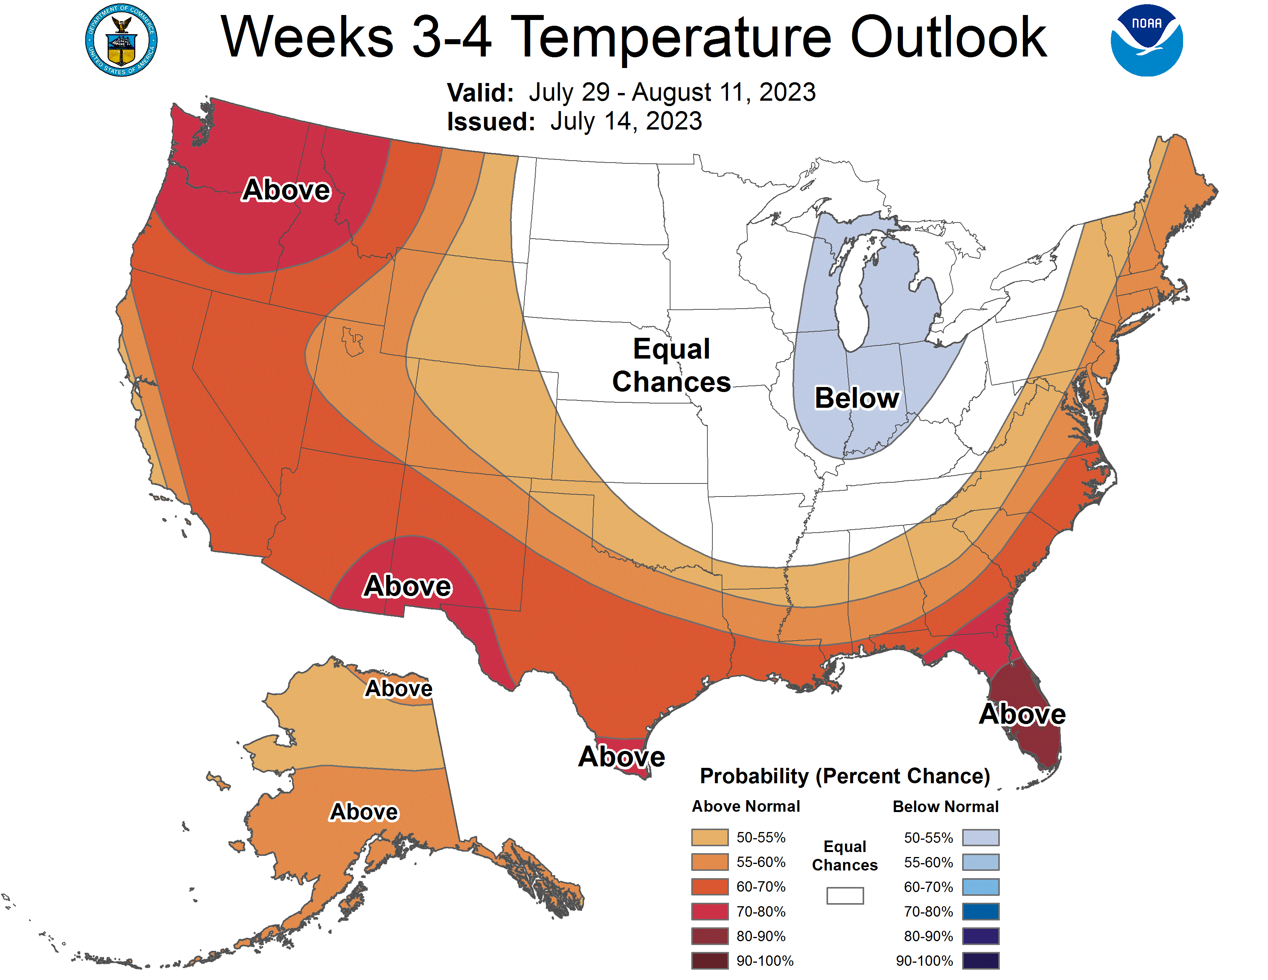
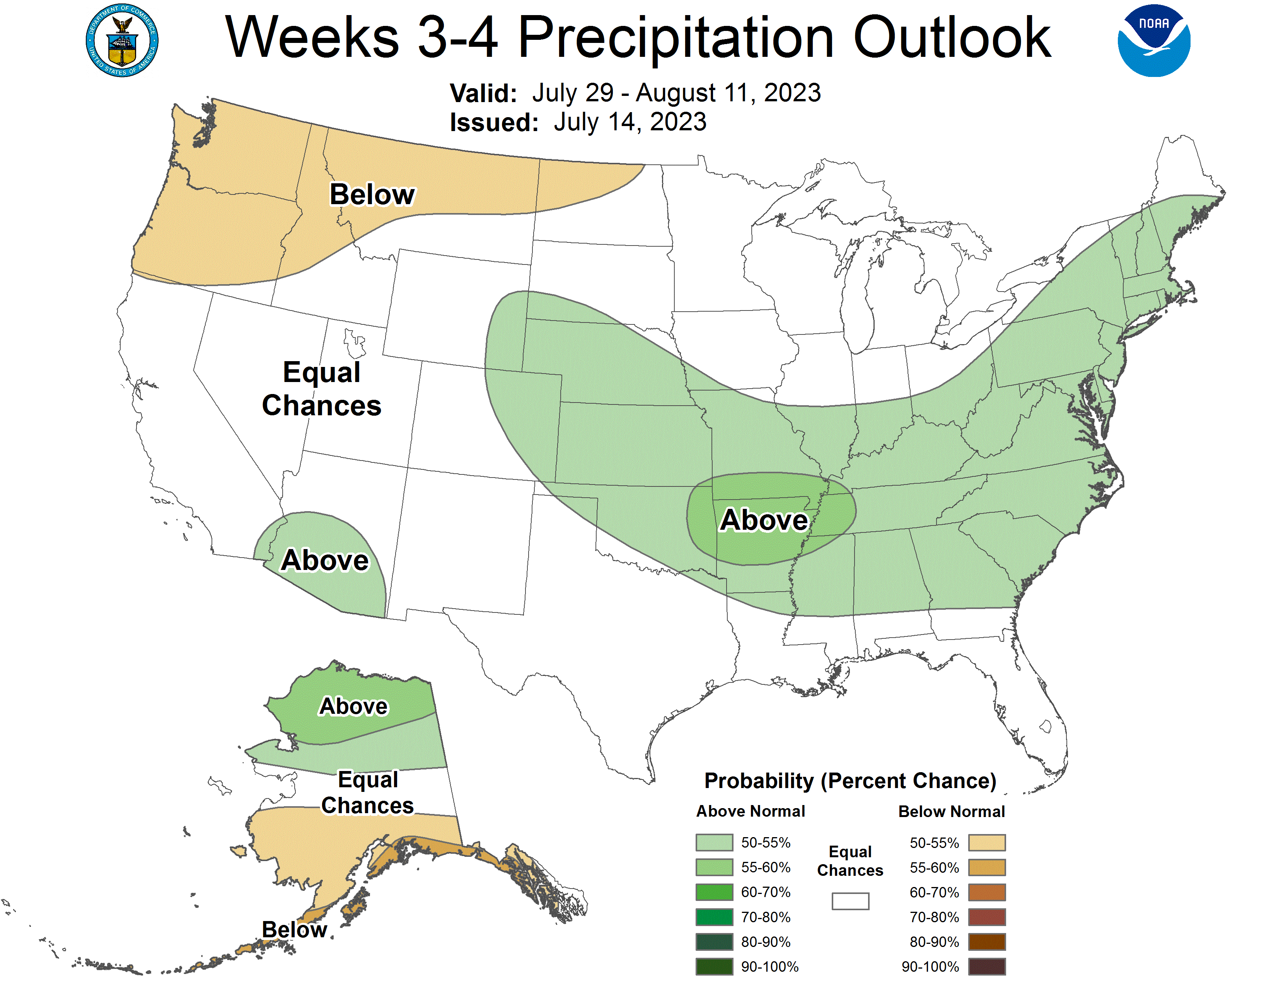
Late July-mid August outlook
Equal chances on temperature for much of Nebraska. Precipitation expected to be above average.
https://www.cpc.ncep.noaa.gov/
Notes:
Here I outlined the similar trends for the Nebraska and global annual average temperature. I also point out the high variability in Nebraska and difference in regional vs. global scales. I use the analogy that global change is like an escalator that is increasing at an accelerating rate. The variability is like we jump up or down a few steps while still going up.

Slide 24
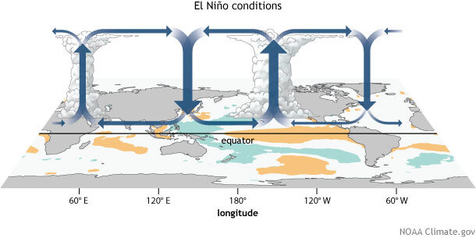
El Nino – why does it matter?
We are officially in El Nino
CPC puts our chances at remaining in El Nino through the northern Hemisphere winter at ~90%
Notes:
Here I outlined the similar trends for the Nebraska and global annual average temperature. I also point out the high variability in Nebraska and difference in regional vs. global scales. I use the analogy that global change is like an escalator that is increasing at an accelerating rate. The variability is like we jump up or down a few steps while still going up.

Slide 25
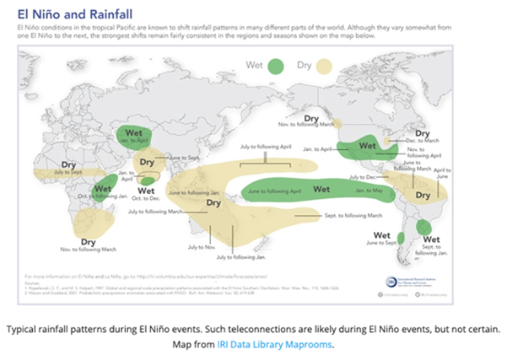
El Nino – why does it matter?
While no two El Nino events are alike, this is the typical precipitation pattern around the globe
Tendency to be wetter than average in our area
https://www.climate.gov/enso
Notes:
Here I outlined the similar trends for the Nebraska and global annual average temperature. I also point out the high variability in Nebraska and difference in regional vs. global scales. I use the analogy that global change is like an escalator that is increasing at an accelerating rate. The variability is like we jump up or down a few steps while still going up.

Slide 26
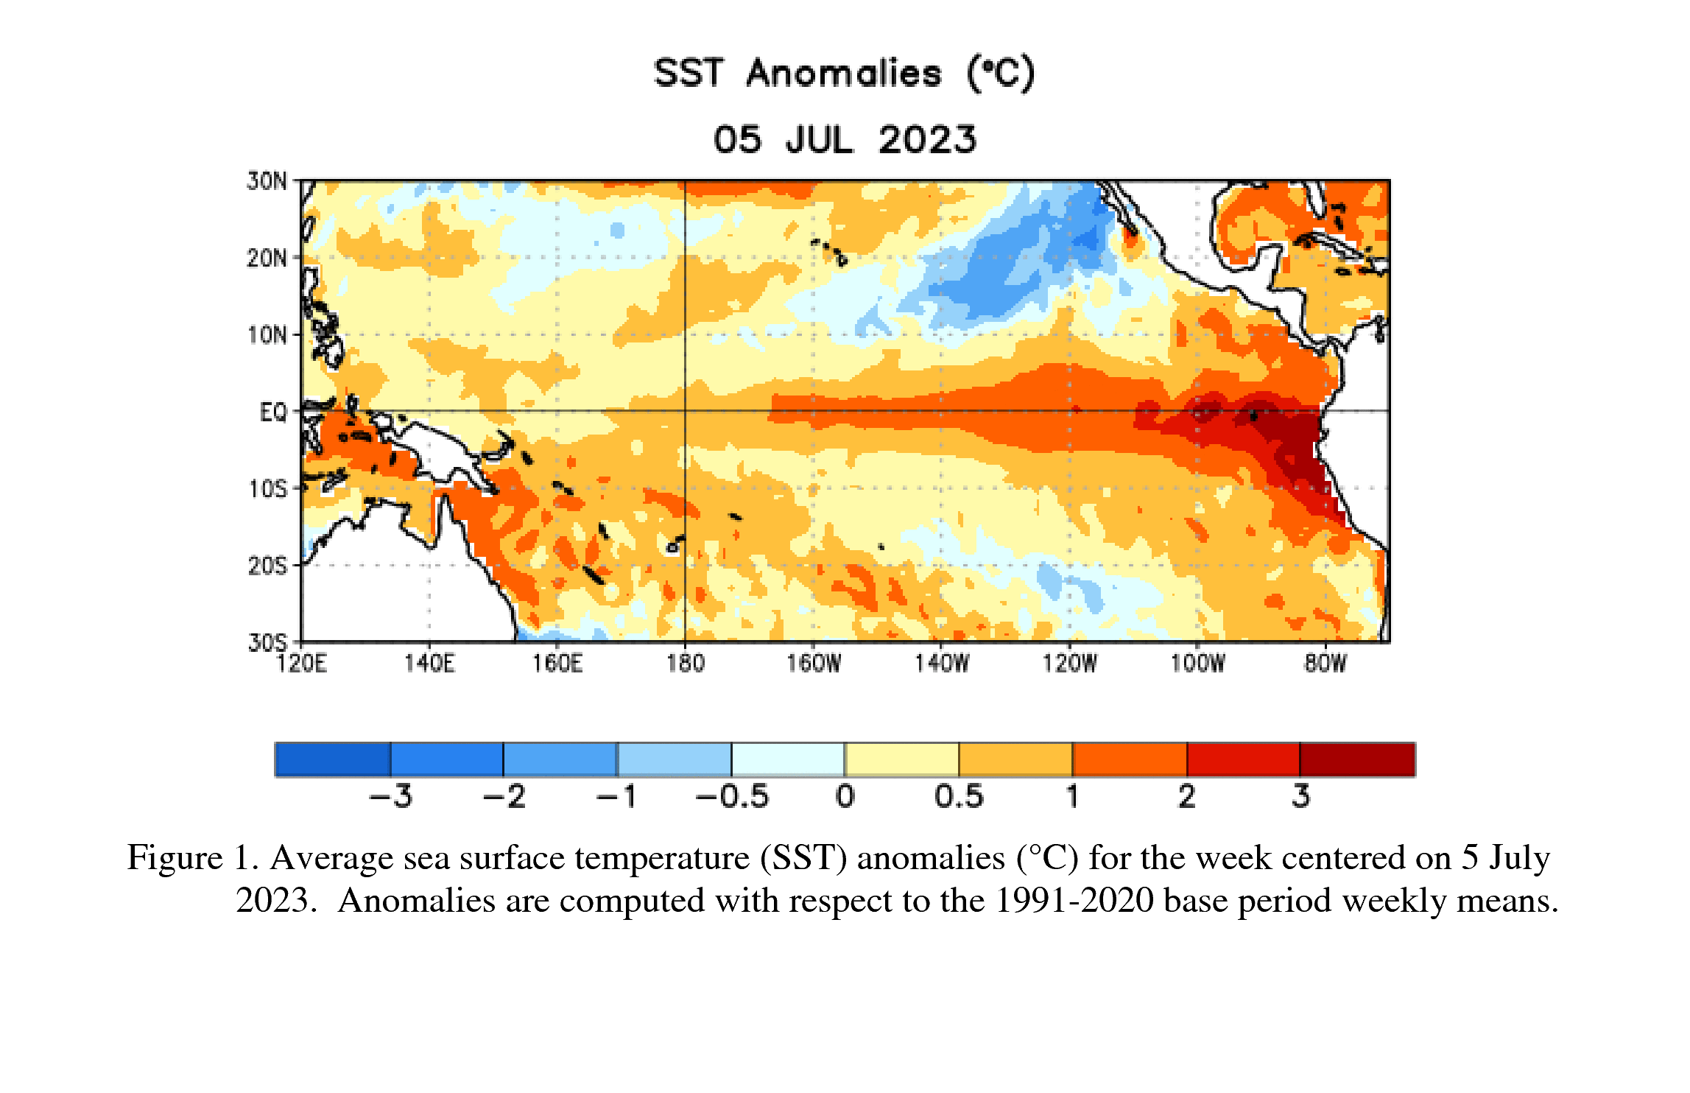
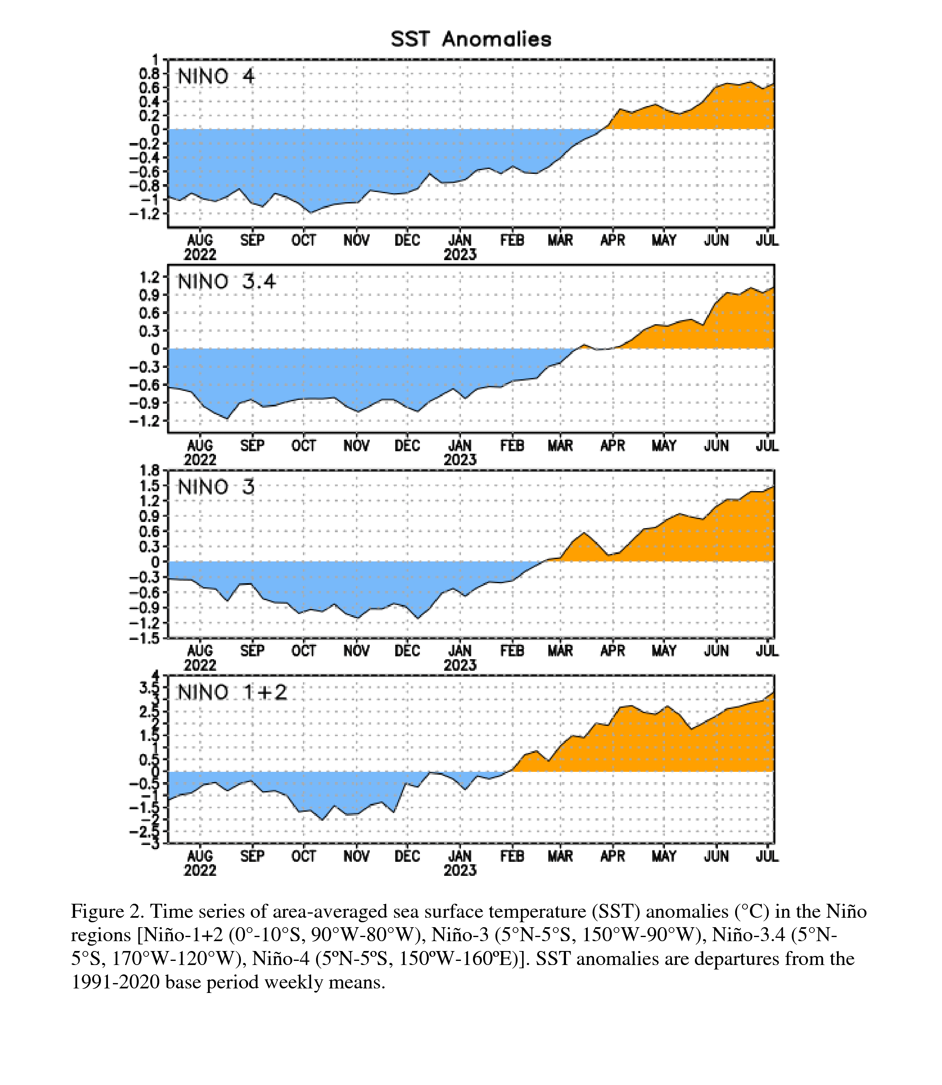
El Nino update
Source: https://www.cpc.ncep.noaa.gov/products/analysis_monitoring/enso_advisory/ensodisc.shtml
Notes:
Here I outlined the similar trends for the Nebraska and global annual average temperature. I also point out the high variability in Nebraska and difference in regional vs. global scales. I use the analogy that global change is like an escalator that is increasing at an accelerating rate. The variability is like we jump up or down a few steps while still going up.

Slide 27
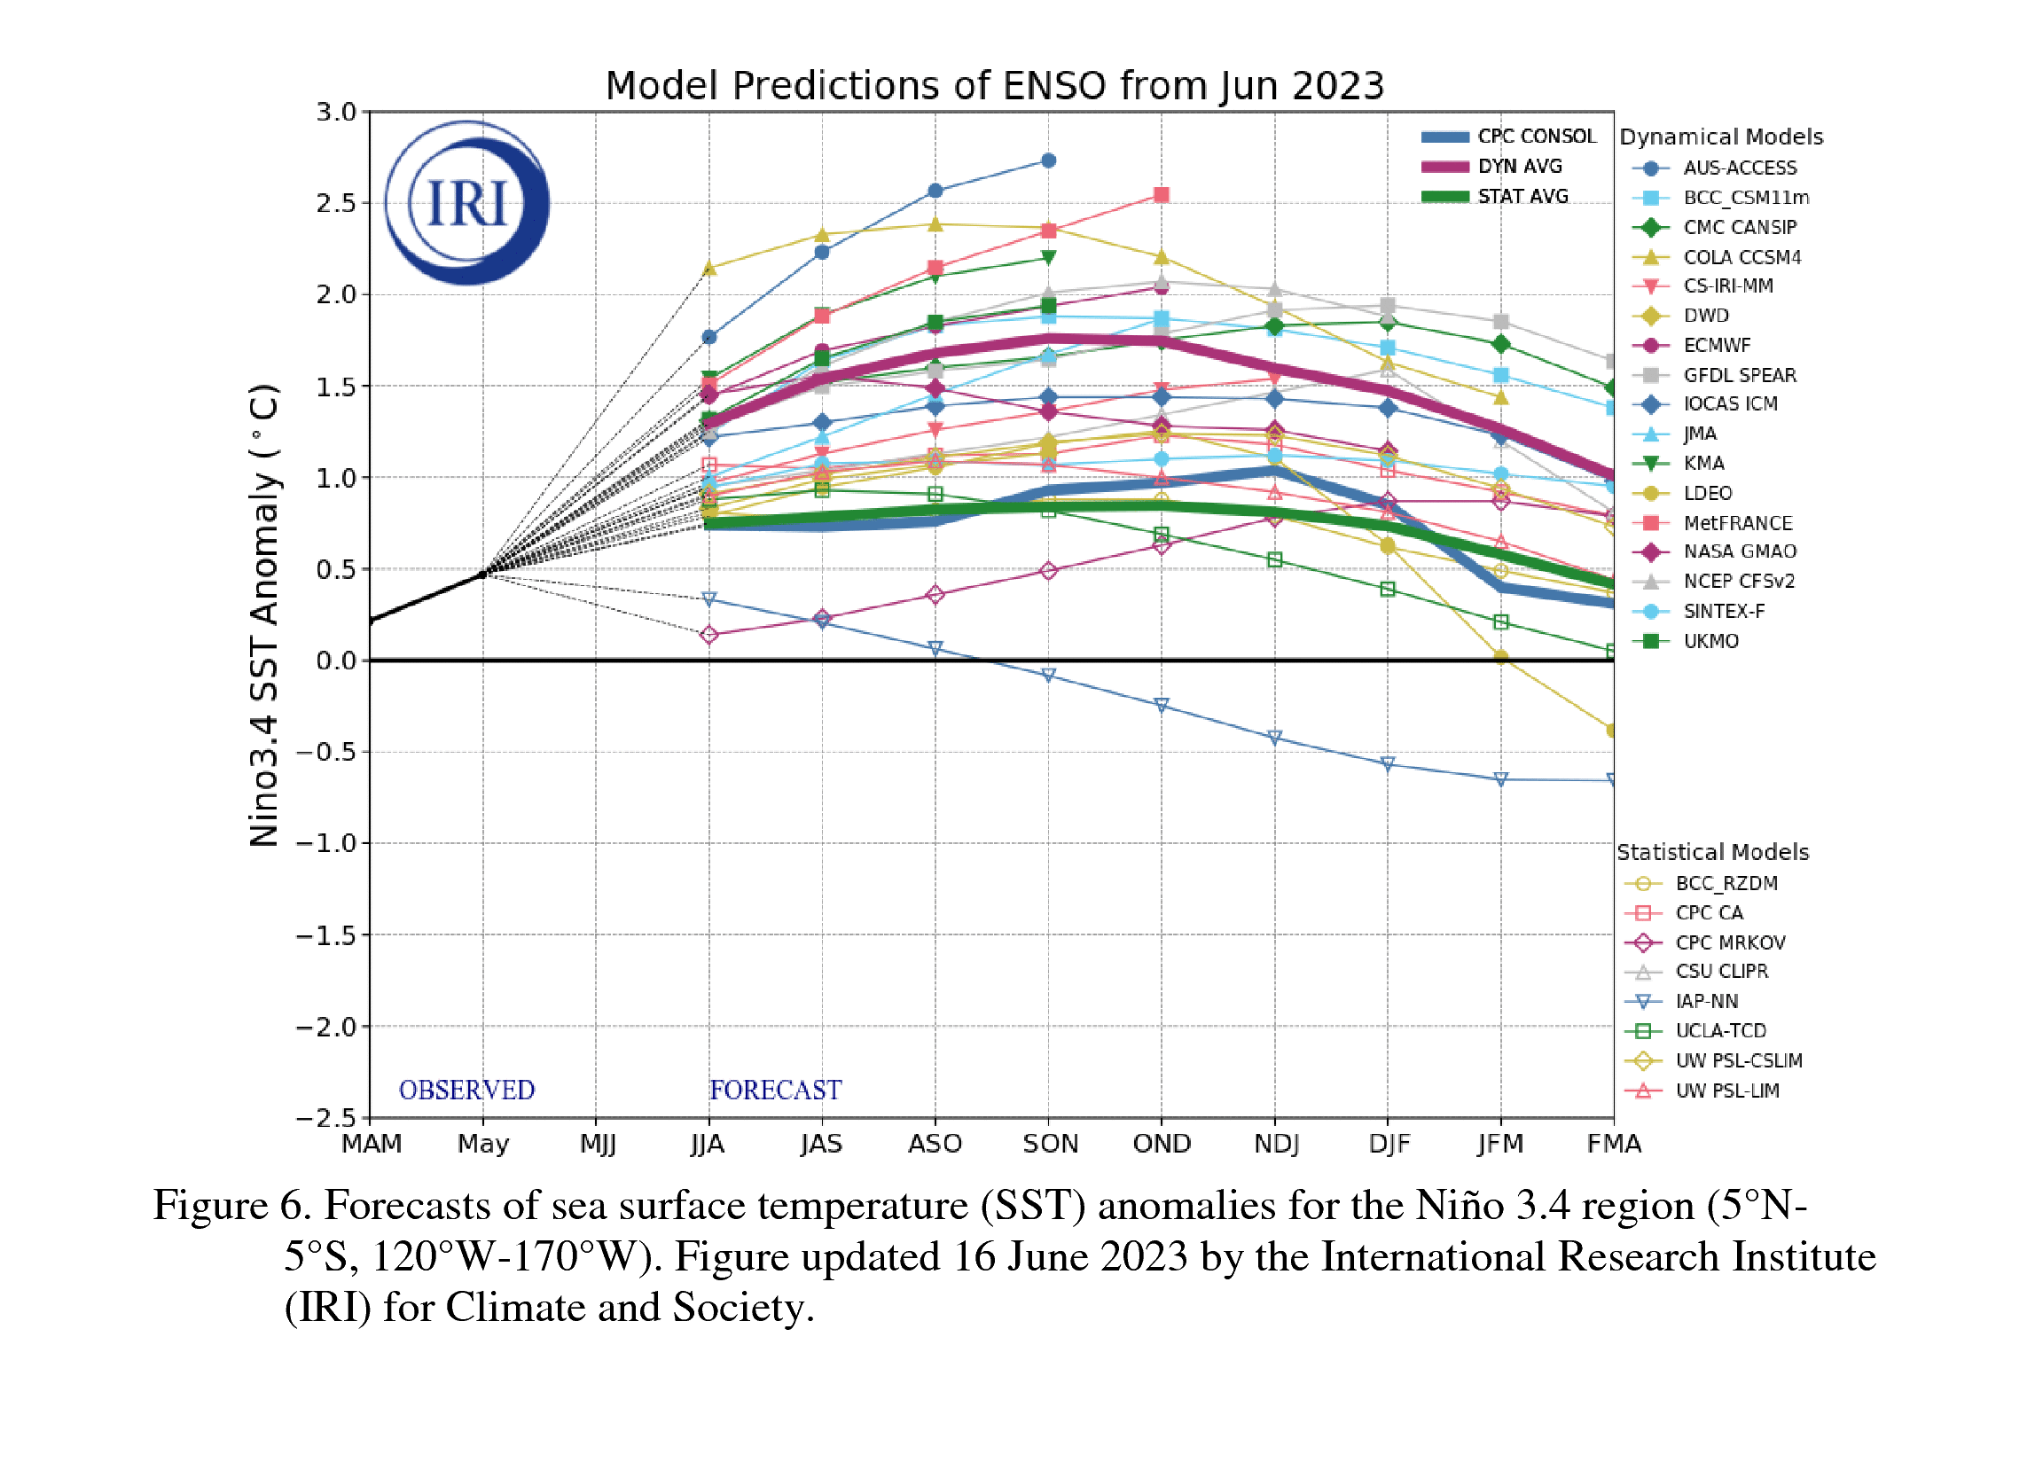
El Nino update
Consensus that El Nino will persist through the winter.
~ 1 in 5 chance that it will become a strong El Nino
Source: https://www.cpc.ncep.noaa.gov/products/analysis_monitoring/enso_advisory/ensodisc.shtml
Notes:
Here I outlined the similar trends for the Nebraska and global annual average temperature. I also point out the high variability in Nebraska and difference in regional vs. global scales. I use the analogy that global change is like an escalator that is increasing at an accelerating rate. The variability is like we jump up or down a few steps while still going up.

Slide 28
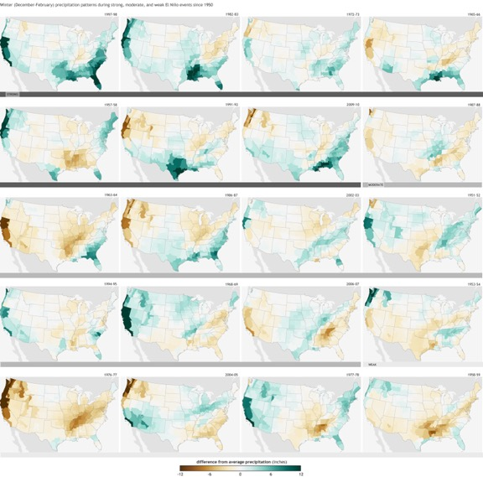
El Nino winter precipitation
Generally wetter but not uniformly.
Analogs of 2006, 2009, and 2018 according to Dr. Judah Cohen of Atmospheric and Environmental Research.
https://www.climate.gov/news-features/blogs/enso/united-states-el-ni%C3%B1o-impacts-0
Notes:
Here I outlined the similar trends for the Nebraska and global annual average temperature. I also point out the high variability in Nebraska and difference in regional vs. global scales. I use the analogy that global change is like an escalator that is increasing at an accelerating rate. The variability is like we jump up or down a few steps while still going up.

Slide 29
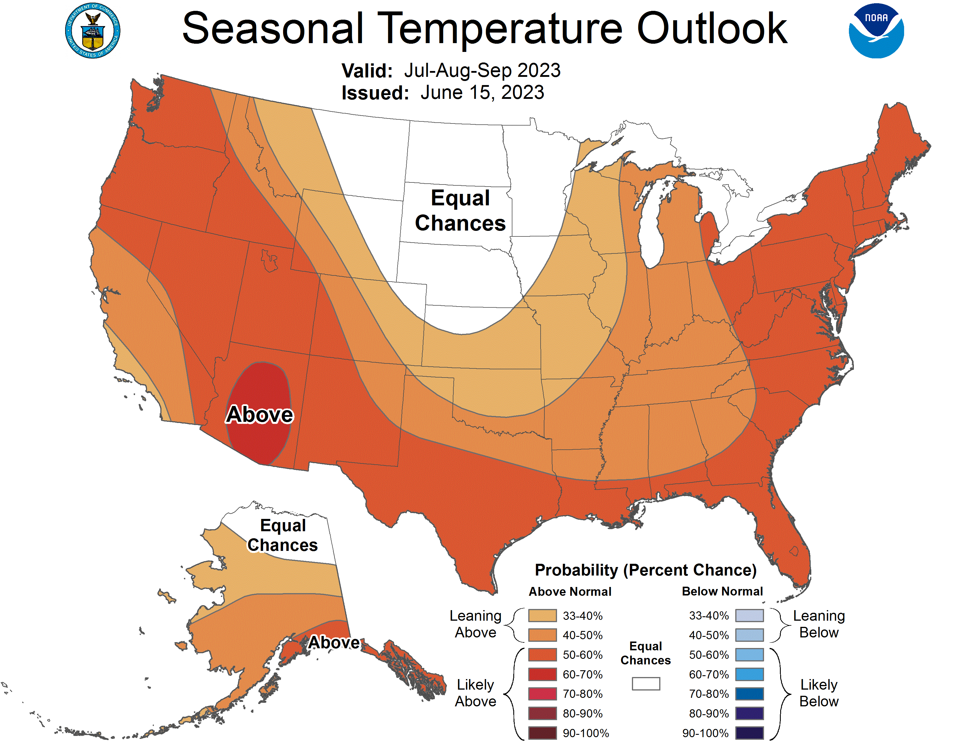
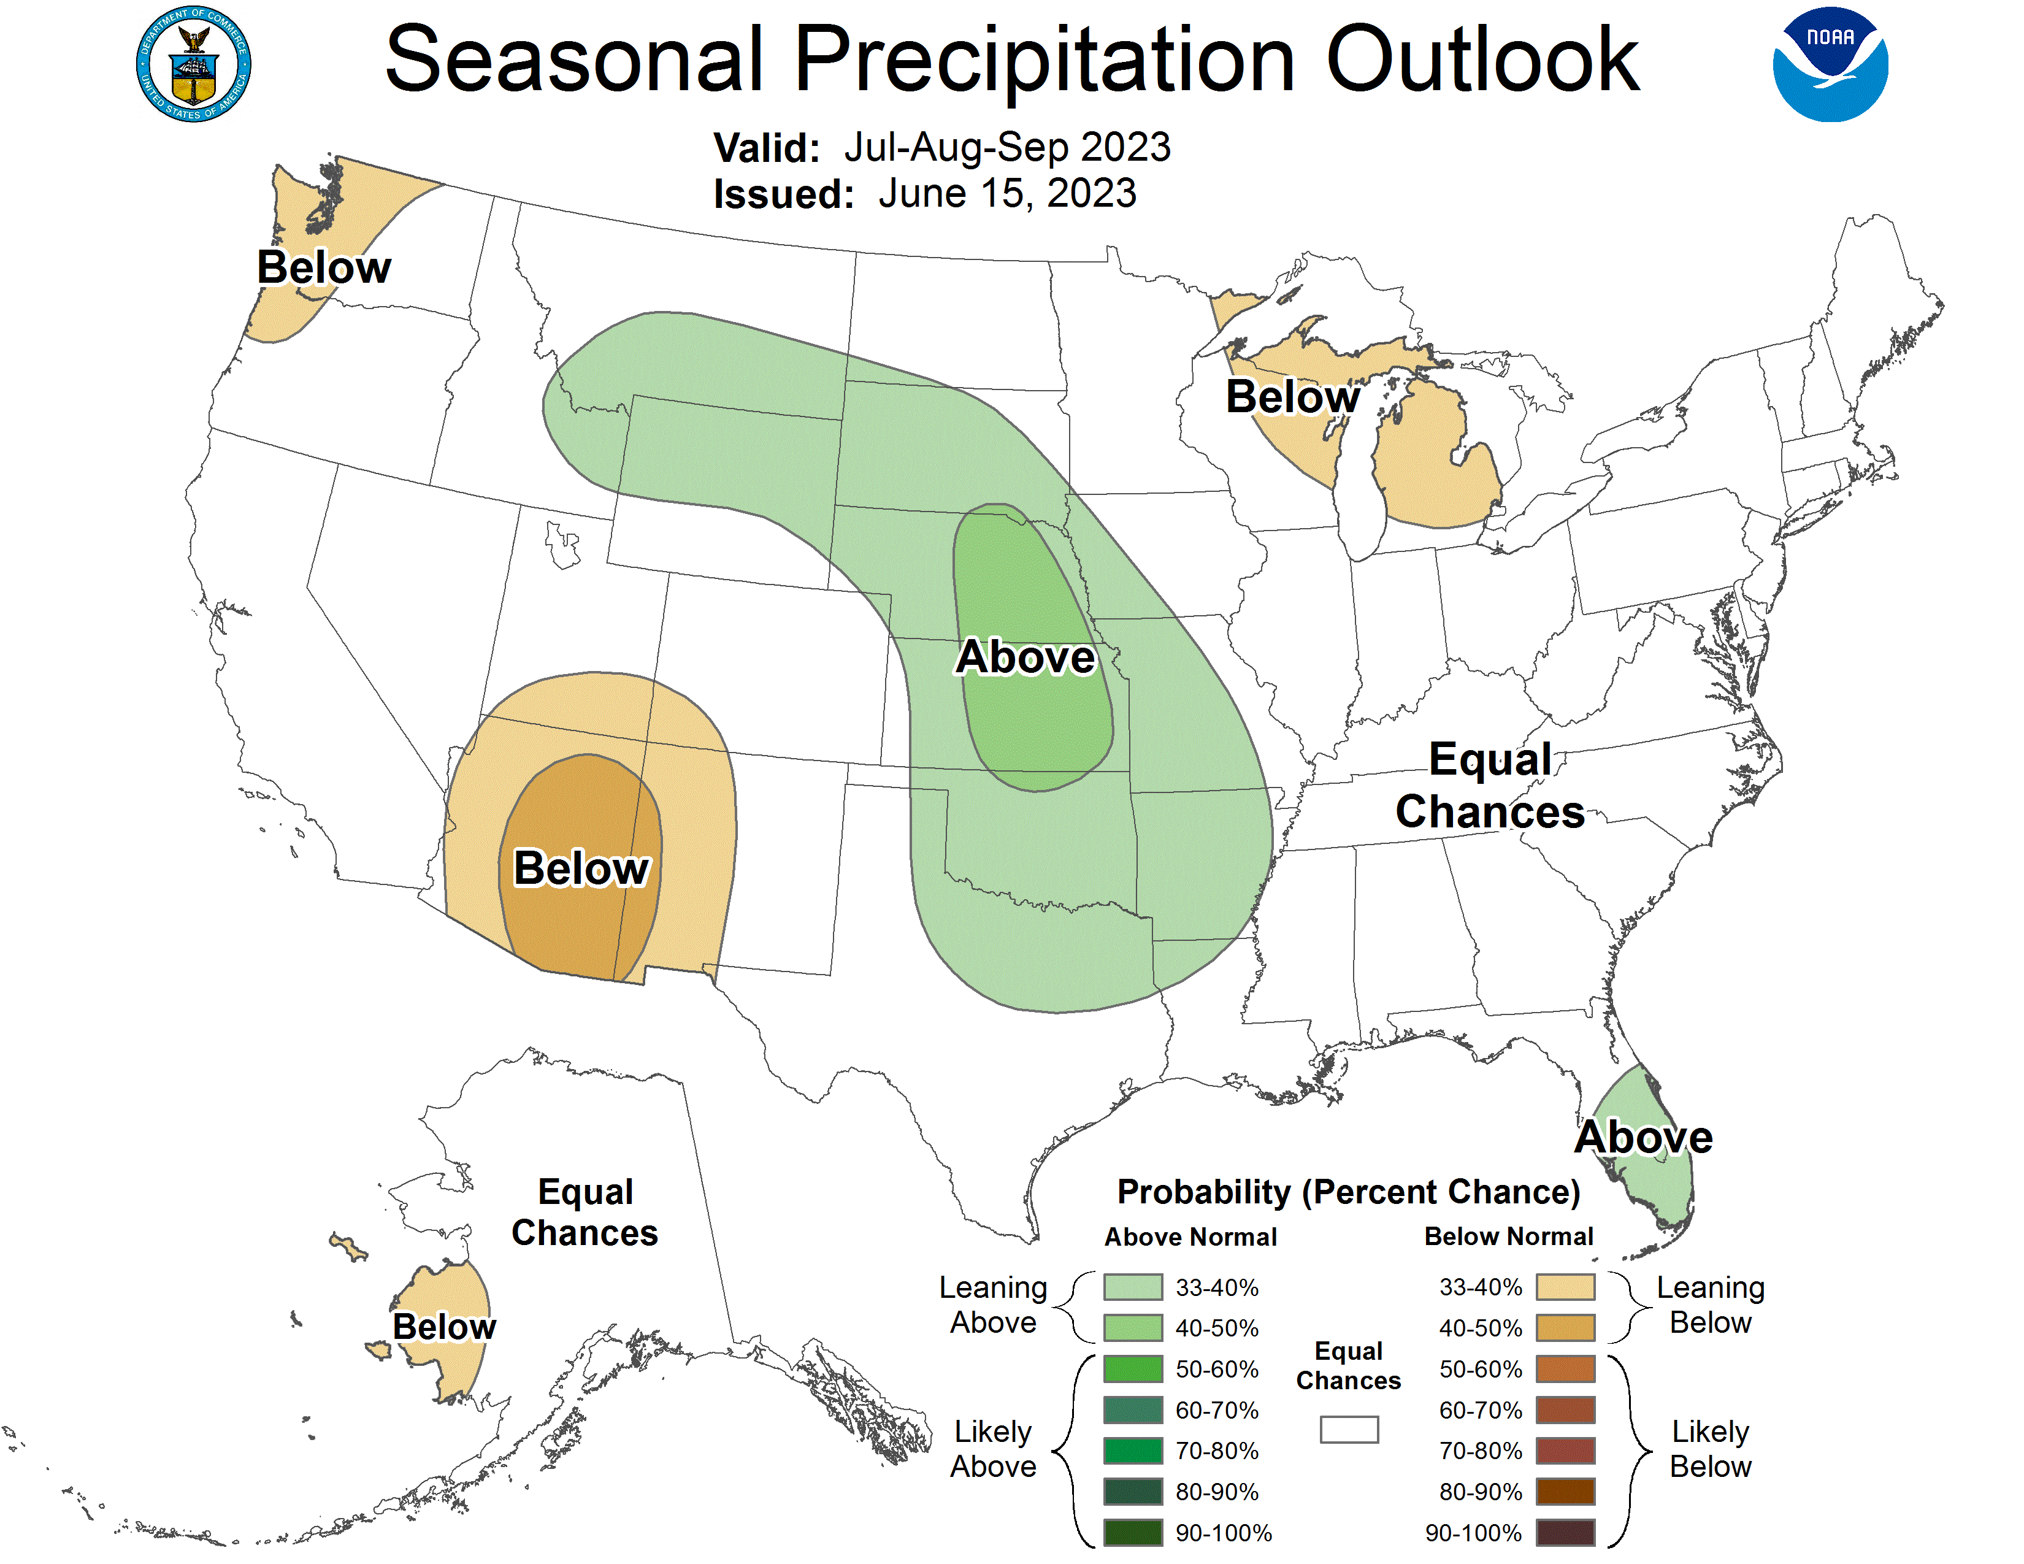
Seasonal outlook (Jul - Sep)
- Equal chances of warm and cooler temperatures. Precipitation expected to be above average.
https://www.cpc.ncep.noaa.gov/
Notes:
Here I outlined the similar trends for the Nebraska and global annual average temperature. I also point out the high variability in Nebraska and difference in regional vs. global scales. I use the analogy that global change is like an escalator that is increasing at an accelerating rate. The variability is like we jump up or down a few steps while still going up.

Slide 30
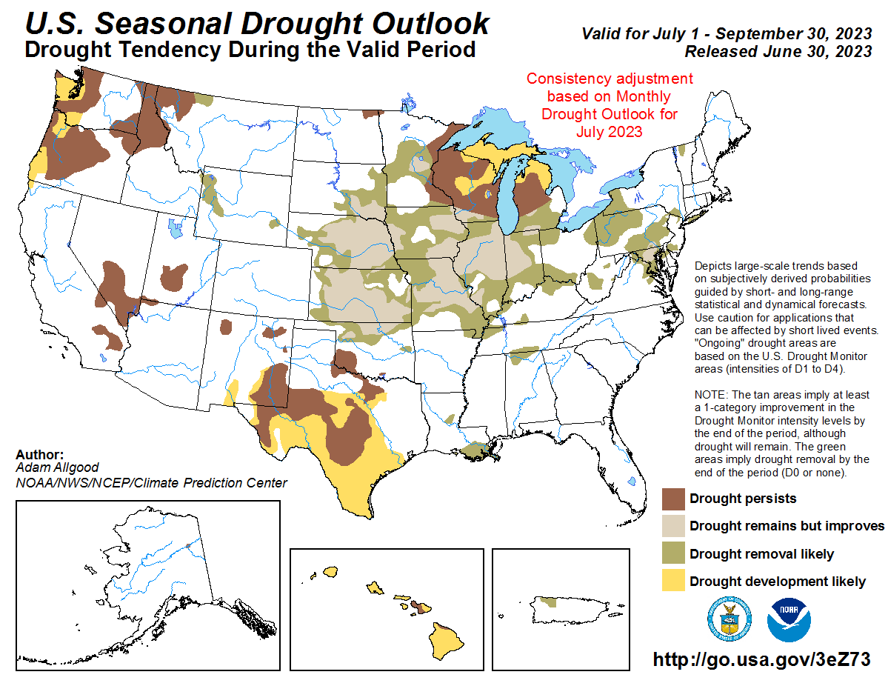
Drought outlook (Jul - Sep)
Widespread improvement likely in Nebraska and throughout much of the Corn Belt .
Some elimination of drought possible in areas where drought is currently less severe
https://www.cpc.ncep.noaa.gov/
Notes:
Here I outlined the similar trends for the Nebraska and global annual average temperature. I also point out the high variability in Nebraska and difference in regional vs. global scales. I use the analogy that global change is like an escalator that is increasing at an accelerating rate. The variability is like we jump up or down a few steps while still going up.

Slide 31
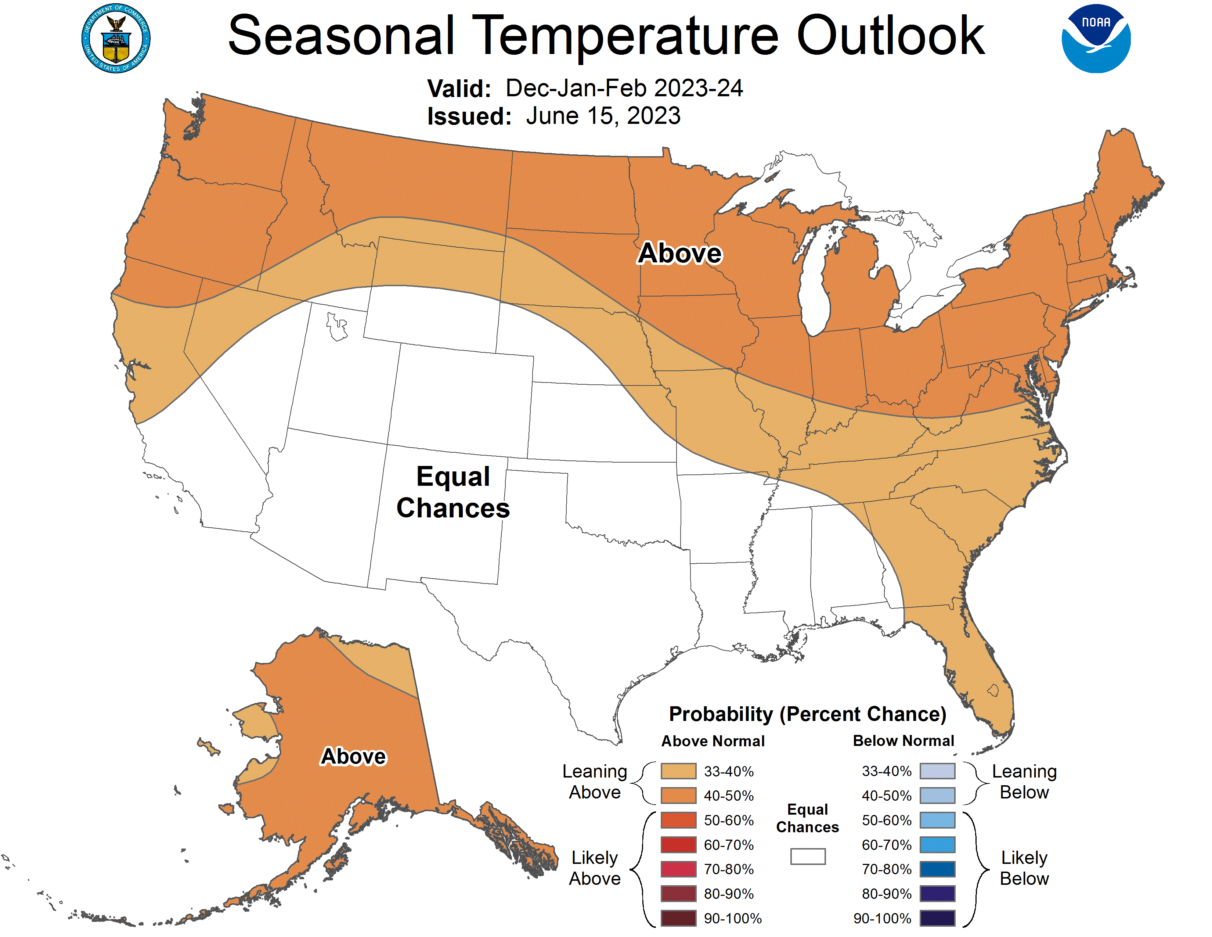
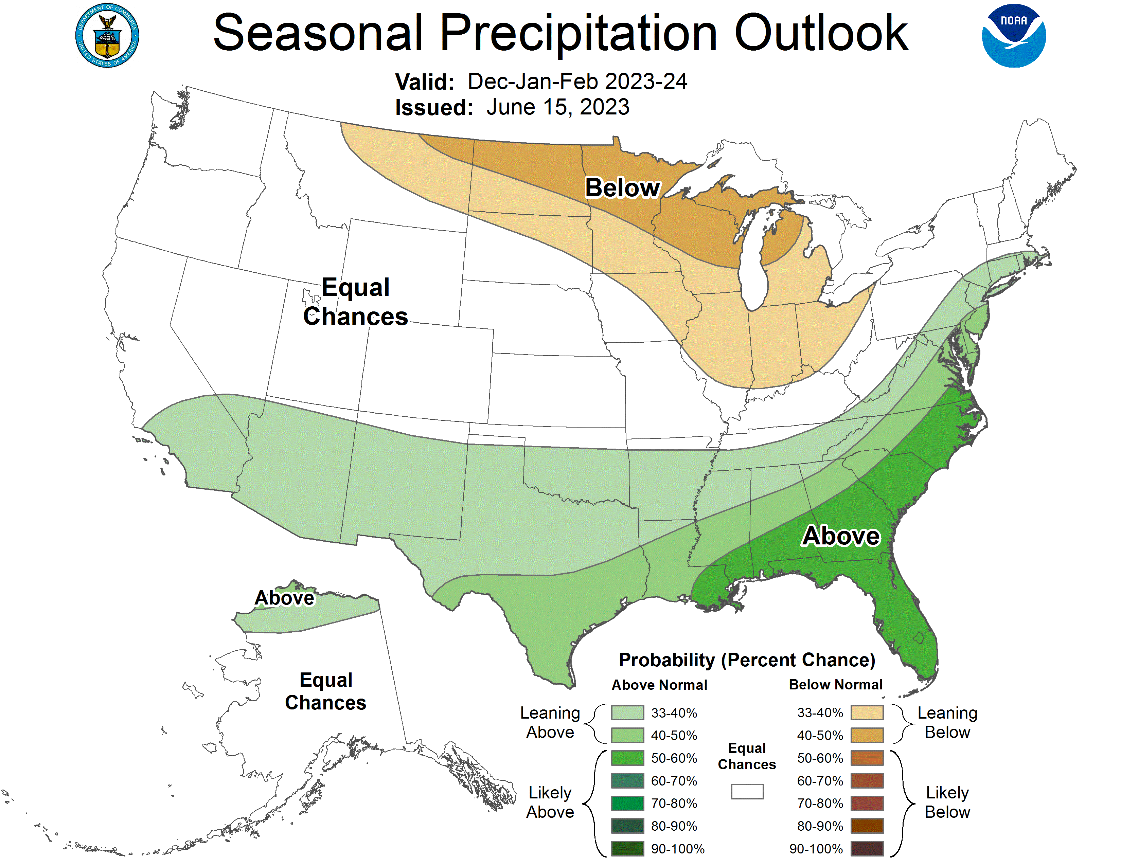
Seasonal outlook (Dec - Feb)
- Outlook heavily weighted toward general temperature and precipitation trends during an El Nino winter.
https://www.cpc.ncep.noaa.gov/
Notes:
Here I outlined the similar trends for the Nebraska and global annual average temperature. I also point out the high variability in Nebraska and difference in regional vs. global scales. I use the analogy that global change is like an escalator that is increasing at an accelerating rate. The variability is like we jump up or down a few steps while still going up.

Slide 32
Key Messages
Significant improvement in drought conditions, or outright elimination of drought, has occurred in most of western Nebraska. Outlook favorable for continued removal of drought.
Historical levels of drought this spring and early summer in eastern Nebraska. But there have been recent improvements and those are expected to continue.
El Nino expected to be around through the northern Hemisphere winter.
Fall likely to be wetter this year than the past three years. Good news for improving drought but perhaps more troublesome for harvest or wheat planting.
Notes:
Here I outlined the similar trends for the Nebraska and global annual average temperature. I also point out the high variability in Nebraska and difference in regional vs. global scales. I use the analogy that global change is like an escalator that is increasing at an accelerating rate. The variability is like we jump up or down a few steps while still going up.

Slide 33
ehunt2@unl.edu 402-617-4190

